Slide 1
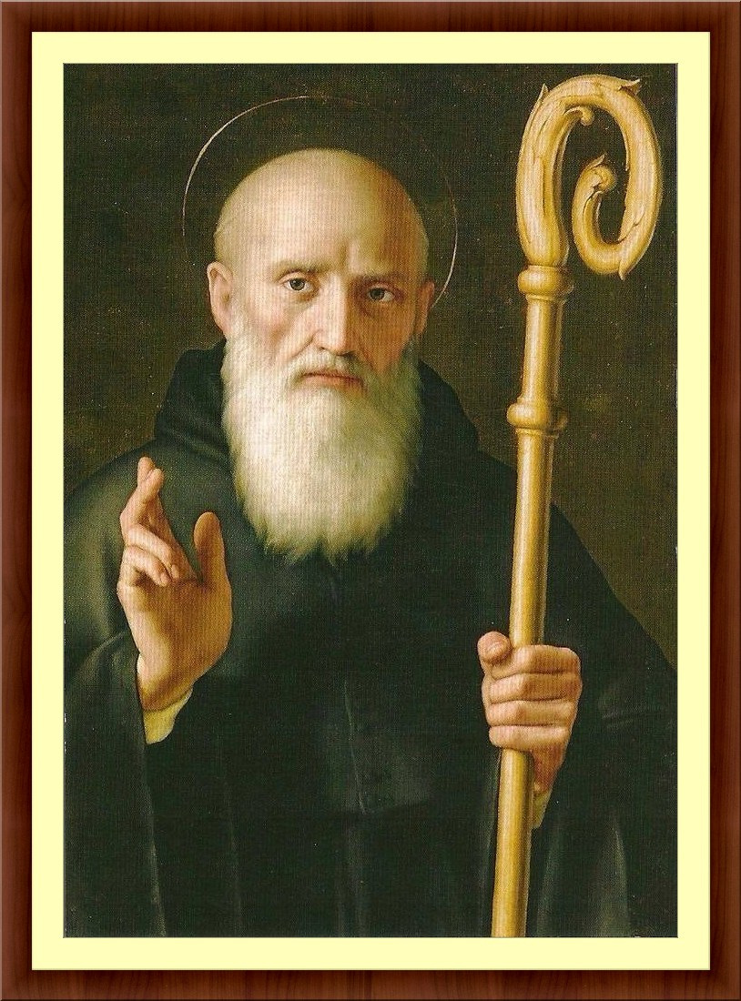
“Listen and Return: A Benedictine Vision for Families”
Is 6th Century
St. Benedict Relevant in the 21st Century?

Slide 2
Monasticism:
Monasticism is the practice of living in a state of separation from the world for the purpose of attaining spiritual perfection.
Who is a monk? The word monk indicates the idea of separation; it is based on the Greek word monos which means alone and one who lives alone.
The end of martyrdom and the end of the era of persecution created a need for new Christian heroes.
Instead of the physical death, Christians can die from the world through a solitary life.
These men and women were sought after for religious counsel, and spiritual healing. Most were later recognized as saints.

Slide 3
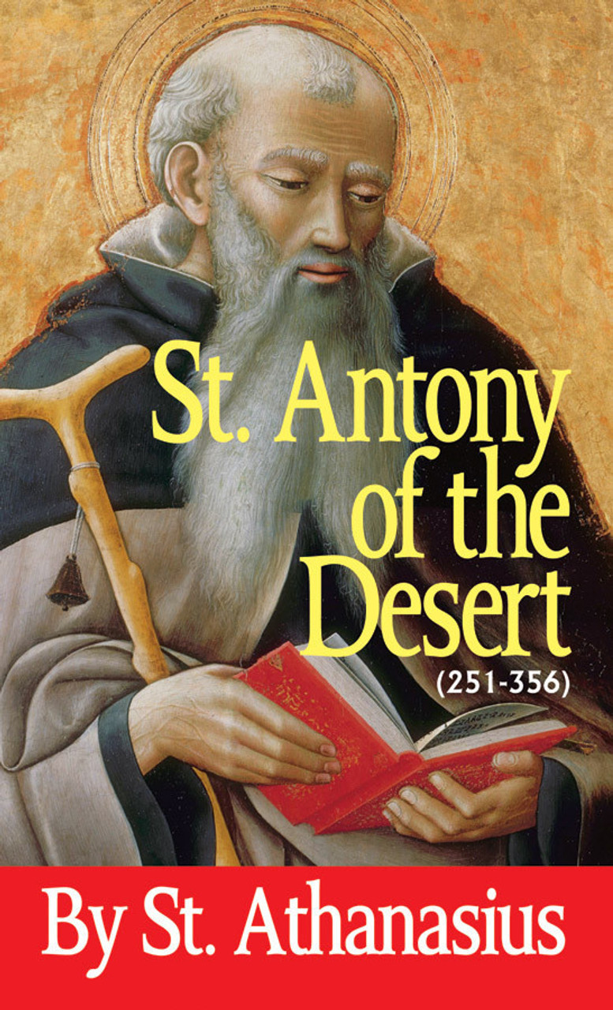
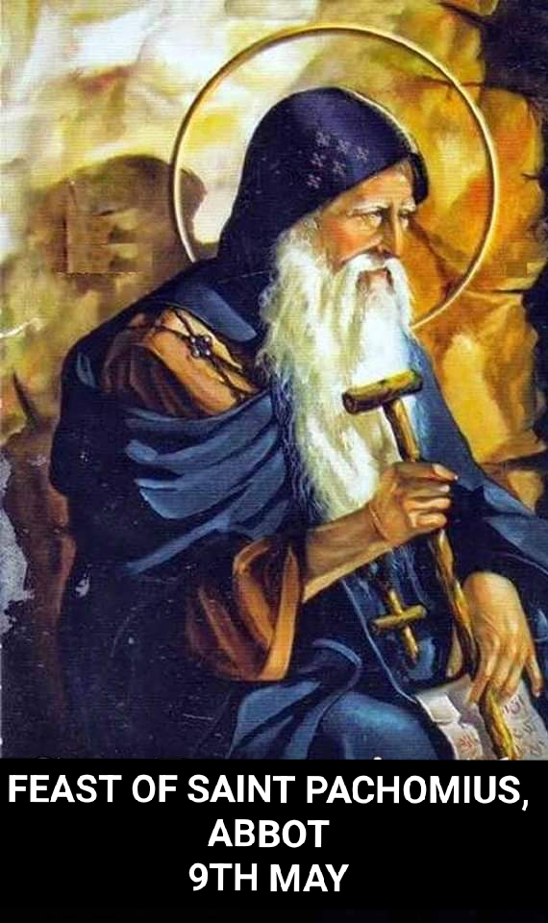
Early Monasticism:
Saint Anthony of the Desert (c. 251 – 356 CE) was said to be an Egyptian holy man who initially lived as a hermit “. . . in the desert lands along the Nile” (Nystrom, 74), but later “He came out of his solitude to organize his disciples into a community of hermits living under a rule, though with much less common life than the later religious orders had”
Others soon followed such as Saint Pachomius (ca. 290 – 346 CE) who helped establish cenobitic monasticism and established a monastery at Tabennisi, ironically on an Island of the Nile in Upper Egypt.

Slide 4
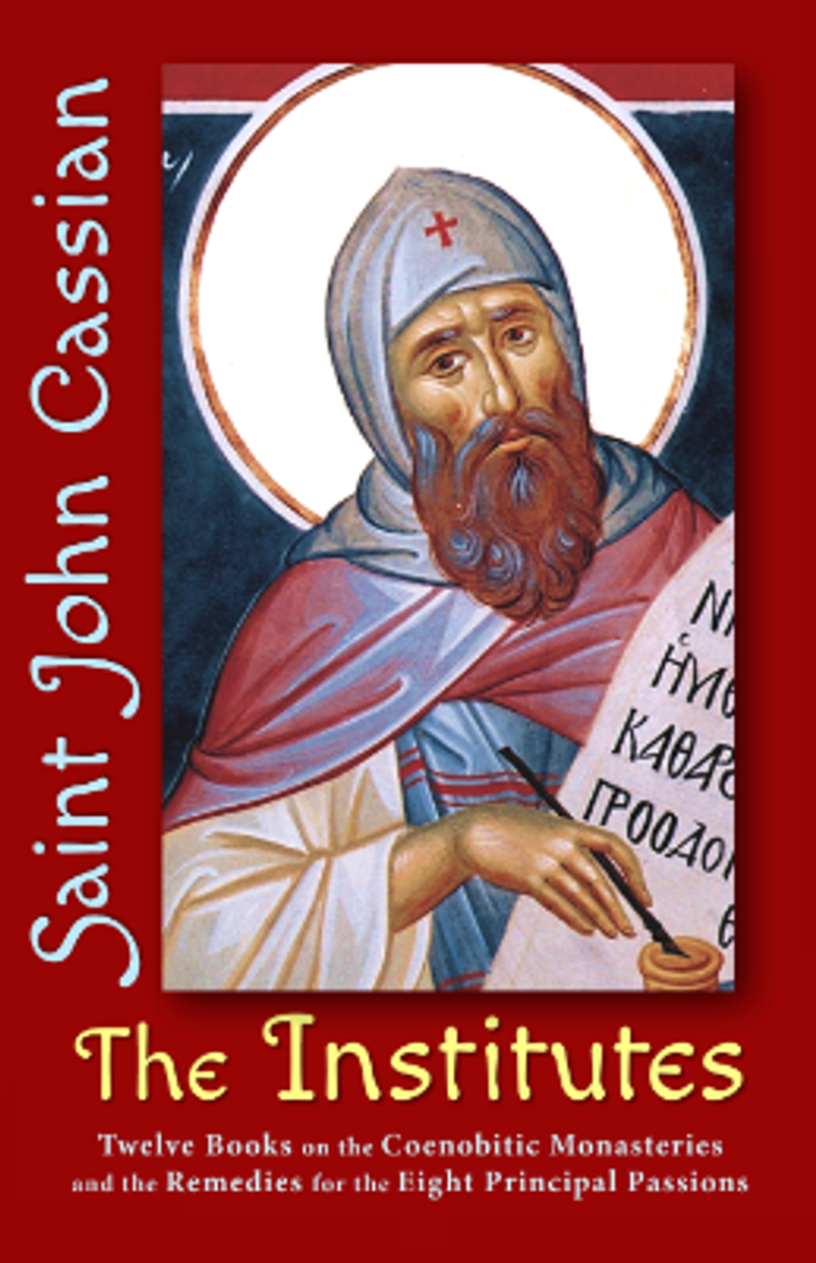
Early Monasticism continued…
In the 4th century CE, the monastic movement spread to the European continent when John Cassian (c. 360 – c. 430 CE), a “Desert Father” and friend of Saint John Chrysostom the “Golden-Mouthed” (c. 347 – 407 CE), founded this Egyptian-style monastery in Gaul (modern-day France).
One of the most famous monastics was Saint Benedict of Nursia (c. 480 – c. 543 CE).

Slide 5
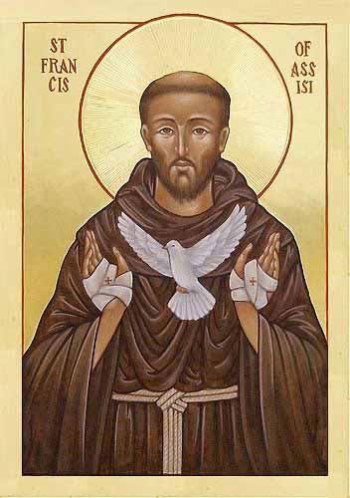
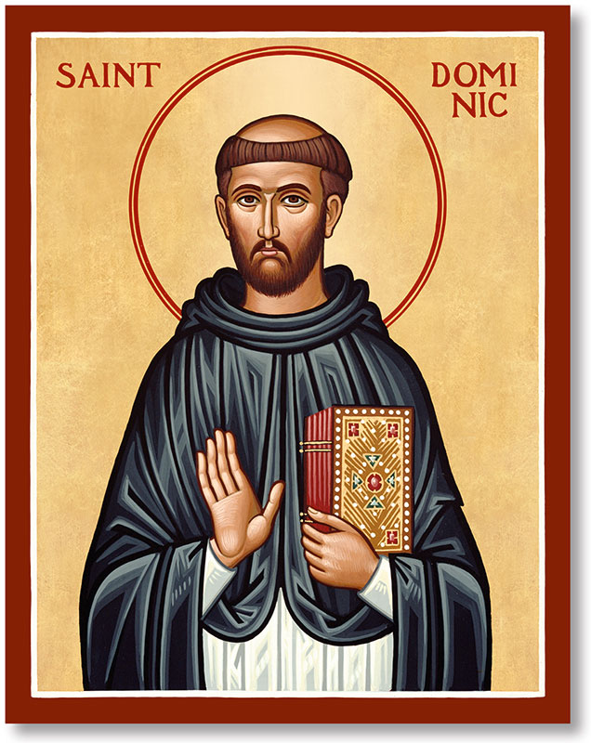
Later Monasticism:
In later medieval Christianity, Cluniac monasticism (c. 909 CE) accentuated simplicity of lifestyle, but even more so focused on prayer and mystic contemplation.
Cistercian monasticism (c. 1098 CE) developed when the emphasis shifted away from menial labor to religious duties.
Saint Francis of Assisi (c. 1181 – 1260 CE) established a mendicant (begging) order that promoted poverty as the vehicle to ensure a holy lifestyle.
Although also a mendicant order, the Dominicans (c. 1220 CE) focused on poverty and scholasticism and sought to bring heretics back to the church through debate and apologetics.

Slide 6
Life of St. Benedict:
St. Benedict is believed to have been born around 480, as the son to a Roman noble of Nurcia, a small town about 70 miles northeast of Rome.
Young Benedict was sent to Rome to finish his education with a nurse/housekeeper. The subject that dominated a young man's study then was rhetoric -- the art of persuasive speaking.

Slide 7
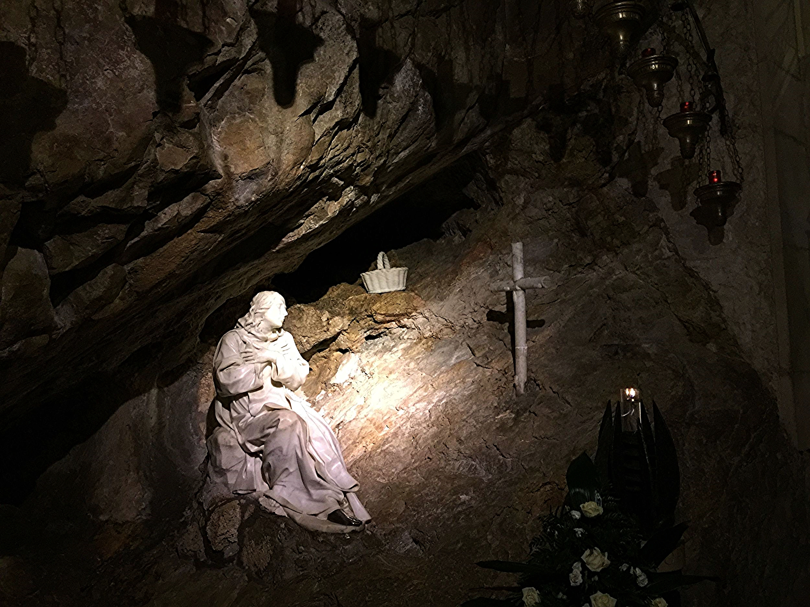
Life of St. Benedict continued…
Afraid for his soul, Benedict fled Rome, gave up his inheritance and lived in a small village with his nurse. When God called him beyond this quiet life to an even deeper solitude, he went to the mountains of Subiaco.
Although becoming a hermit was not his purpose in leaving, there he lived as a hermit under the direction of another hermit, Romanus.
After several years of solitude dwelling alone with himself in the presence of the heavenly Father (Pope St. Gregory, Dialogues, II), many disciples joined him and he founded near-by twelve monasteries with 12 monks in each.

Slide 8
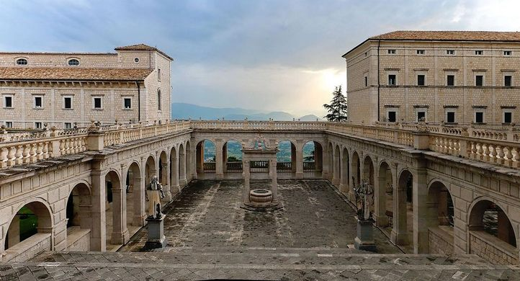
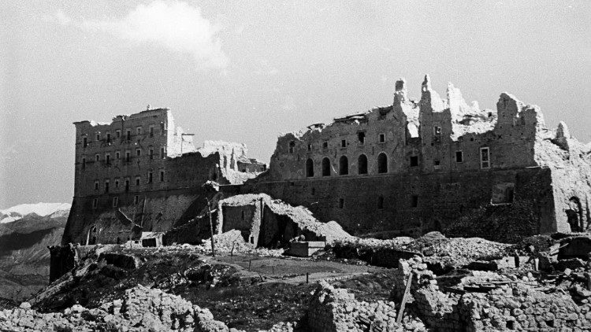
Life of St. Benedict continued…
He built a bigger monastery at Monte Cassino near Naples and wrote his Rule.
According to the tradition, he died there on 21 March 547.
The Benedictine Order has given the Church over 57,000 known saints and 35 popes, of whom 17 are Saints or Blesseds.

Slide 9
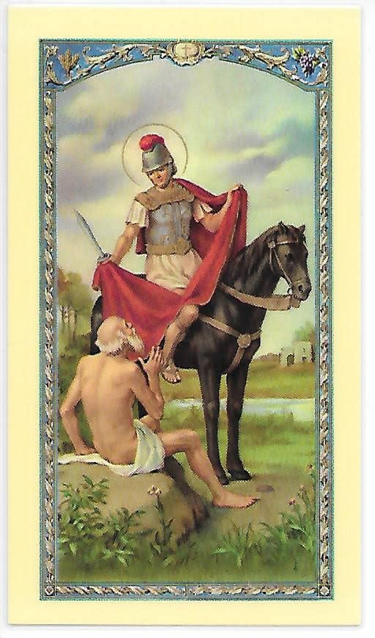
The Rule of St. Benedict:
He studied all the main Christian monastic texts written before him: St. Antony’s life (251-356), written by St. Athansius of Alexandria;
St. Basil’s Asketicon (Rule of St. Basil)
Rules of St. Pachomius (292-346)
Desert fathers
The Life of St. Martin of Tours (316-397)
Works of Cassian (Institutes and Conferences) (330-379)
St Augustine (354-430)
Rule of the Master

Slide 10
The Rule of St. Benedict:
The Rule is the meeting place of the Eastern and Christian traditions.
Prologue + 73 chapters (The Catholic Bible is composed of 73 books: an Old Testament of 46 books (including 7 deuterocanonical books and additional deuterocanonical content in 2 books) and a New Testament of 27 books.)
These include the books of Tobit, Judith, 1 Maccabees, 2 Maccabees, Wisdom, Ecclesiasticus (Sirach), and Baruch, along with some "additions" to the books of Daniel and Esther.

Slide 11
1. Work
1.1 Domestic work
The brothers should serve one another. Consequently, no one will be excused from kitchen service unless he is sick or engaged in some important business of the monastery, for such service increases reward and fosters love.
The Rule of St Benedict, Chapter 35

Slide 12
1.2. Professional work
If there are artisans in the monastery, they are to practice their craft with all humility, but only with the abbot’s permission. If one of them becomes puffed up by his skillfulness in his craft, and feels that he is conferring something on the monastery, he is to be removed from practicing his craft and not allowed to resume it unless, after manifesting his humility, he is so ordered by the abbot.
Rule of St Benedict, Chapter 57

Slide 13
2. Rest
All the monks will sit together immediately after rising from supper. Someone should read from the Conferences or the Lives of the Fathers or at any rate something else that will beneﬁt the hearers, but not the Heptateuch or the Book of Kings, because it will not be good for those of weak understanding to hear these writings at that hour… On arising [in the morning] for the Work of God, they will quietly encourage each other, for the sleepy like to make excuses.
Rule of St Benedict, Chapters 42 and 22

Slide 14
3. Meals
If anyone does not come to table before the verse so that all may say the verse and pray and sit down at table together, and if this failure happens through the individual’s own negligence or fault, he should be reproved up to the second time. … For nothing is so inconsistent with the life of any Christian as overindulgence. Our Lord says: Take care that your hearts are not weighed down with overindulgence. … Reading will always accompany the meals of the brothers.
Rule of St Benedict, Chapters 43, 39 and 38

Slide 15
4. Clothes
We believe that for each monk a cowl and tunic will sufﬁce… also a scapular… Brothers going on a journey… their cowls and tunics, too, ought to be somewhat better than those they ordinarily wear.
Rule of St Benedict, Chapter 55

Slide 16
5. Going out…
Monastic life presumes a close communion with one’s own community, life and all its needs. For St Benedict there is no room in such a community for the individualism and a social and selﬁsh indifference which unfortunately are so widespread today.

Slide 17
6. The surroundings
The monastery should, if possible, be so constructed that within it all necessities, such as water, mill and garden are contained, and the various crafts are practiced. Then there will be no need for the monks to roam outside, because this is not at all good for their souls.
Rule of St Benedict, Chapter 66

Slide 18
7. Furnishings
Whoever fails to keep the things belonging to the monastery clean or treats them carelessly should be reproved. If he does not amend, let him be subjected to the discipline of the rule. Rule of St Benedict, Chapter 32

Slide 19
8. Tools
In order that this vice of private ownership may be completely uprooted, the abbot is to provide all things necessary: that is, cowl, tunic, sandals, shoes, belt, knife, stylus, needle, handkerchief and writing tablets. In this way every excuse of lacking some necessity will be taken away. … Anything more must be taken away as superﬂuous.
Rule of St Benedict, Chapter 55

Slide 20
9. The arrangement of the house
The house of God should be in the care of wise men who will manage it wisely… so that no one may be disquieted or distressed in the house of God.
Rule of St Benedict, Chapters 53 and 31

Slide 21
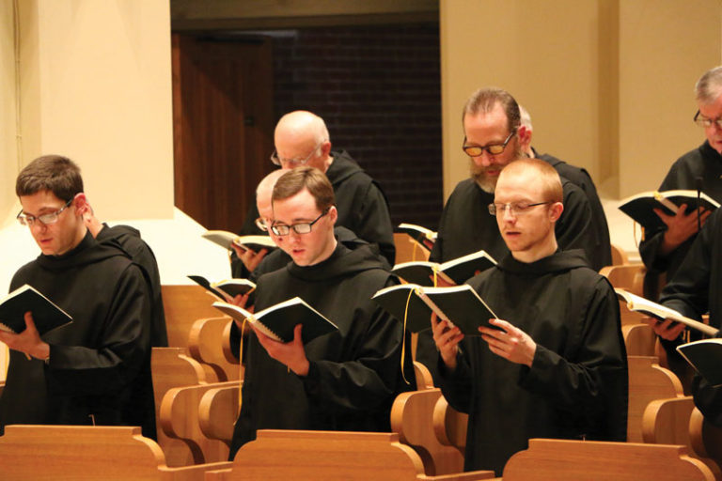
9.1 A place for worship
The oratory ought to be what it is called, and nothing else is to be done or stored there.
Rule of St Benedict, Chapter 52

Slide 22
9.2 The library
Besides the inspired books of the Old and New Testaments, the works read at Vigils should include explanations of Scripture by reputable and orthodox catholic Fathers… What page, what passage of the inspired books of the Old and New Testaments is not the truest of guides for human life? What book of the holy catholic Fathers does not resoundingly summon us along the true way to reach the Creator? Then, besides the Conferences of the Fathers, their Institutes and their Lives, there is also the rule of our holy father Basil. For observant and obedient monks, all these are nothing less than tools for the cultivation of virtues… During this time of Lent each one is to receive a book from the library, and is to read the whole of it straight through. These books are to be distributed at the beginning of Lent.
Rule of St Benedict, Chapters 9, 73 and 48

Slide 23
9.3 The space for work in common
Idleness is the enemy of the soul. Therefore, the brothers should have speciﬁed periods for manual labour as well as for prayerful reading.
Rule of St Benedict, Chapter 48

Slide 24
9.4 Artistic adornment
When they live by the labor of their hands, as our fathers and the apostles did, then they are really monks.
Rule of St Benedict, Chapter 48

Slide 25
9.5 Devotional objects and images
The ﬁrst step of humility, then, is that a man keeps the fear of God always before his eyes and never forgets it.
Rule of St Benedict, Chapter 7

Slide 26
10. Prayer 10.1 Prayer in common
Therefore, we should praise our Creator for his just judgements at these times… and let us arise at night to give him praise.
Rule of St Benedict, Chapter 16

Slide 27
10.2 Private prayer
Moreover, if at other times someone chooses to pray privately, he may simply go in and pray, not in a loud voice, but with tears and heartfelt devotion.
Rule of St Benedict, Chapter 52

Slide 28
11. Charity 11.1 Charity within the family and mutual service
This, then, is the good zeal which monks must foster with fervent love: They should each try to be the ﬁrst to show respect to the other, supporting with the greatest patience one another’s weaknesses of body or behavior, and earnestly competing in obedience to one another. No one is to pursue what he judges better for himself, but instead, what he judges better for someone else.
Rule of St Benedict, Chapter 72

Slide 29
11.2 Charity beyond the family
You must relieve the lot of the poor, clothe the naked, visit the sick, and bury the dead. Go to help the troubled and console the sorrowing… Great care and concern are to be shown in receiving poor people and pilgrims, because in them more particularly Christ is received; our very awe of the rich guarantees them special respect.
Rule of St Benedict, Chapters 4 and 53

Slide 30
12. Fraternal dialogue. The times and means of conversation and silence
The reason why we have said all should be called for counsel is that the Lord often reveals what is better to the younger… The decision is rather the abbot’s to make… Nevertheless, just as it is proper for disciples to obey their master, so it is becoming for the master on his part to settle everything with foresight and fairness… Monks should diligently cultivate silence at all times, but especially at night.
Rule of St Benedict, Chapters 3 and 42

Slide 31
13. Reading
Listen readily to holy reading
Rule of St Benedict, Chapter 4

Slide 32
14. Study
The reason we have written this rule is that, by observing it in monasteries, we can show that we have some degree of virtue and the beginnings of monastic life. But for anyone hastening on to the perfection of monastic life, there are the teachings of the holy Fathers, the observance of which will lead him to the very heights of perfection. What page, what passage of the inspired books of the Old and New Testaments is not the truest of guides for human life? What book of the holy catholic Fathers does not resoundingly summon us along the true way to reach the Creator? … Are you hastening towards your heavenly home? Then with Christ’s help, keep this little rule that we have written for beginners. After that, you can set out for the loftier summits of the teaching and virtues we mentioned above, and under God’s protection you will reach them.
Rule of St Benedict, Chapter 73

Slide 33
15. Music and sacred and secular song
Brothers will read and sing, not according to rank, but according to their ability to beneﬁt their hearers.
Rule of St Benedict, Chapter 38

